Slide 1

Transport Layer (TCP)
Lecture 5 | CSE421 – Computer Networks
Department of Computer Science and Engineering
School of Data & Science

Slide 2
Objectives
TCP Header
TCP Services

Slide 3
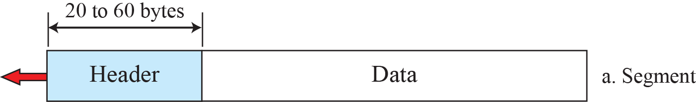
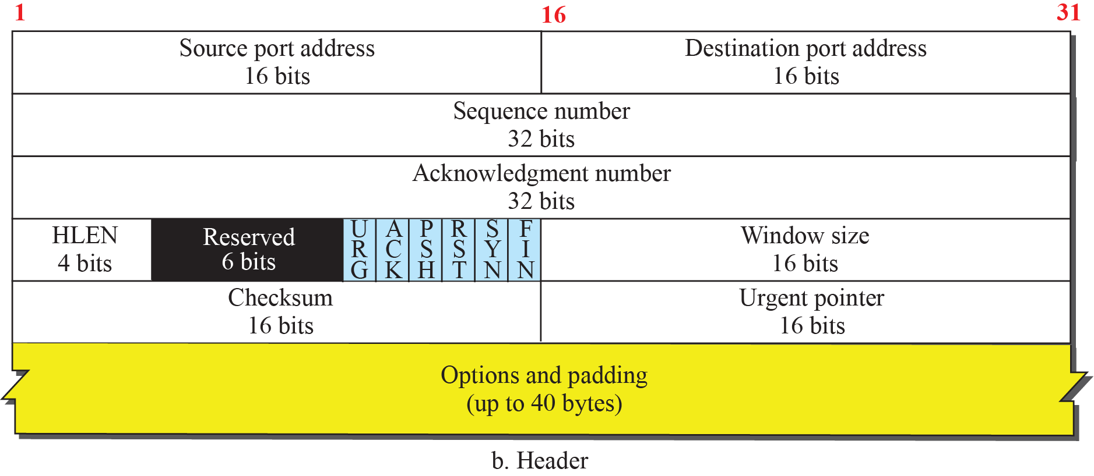
TCP Segment Header

Slide 4
Byte Number
The bytes of data being transferred in each connection are numbered by TCP.
The numbering starts with an arbitrarily generated number.
An arbitrary number between 0 and 2³² − 1 for the number of the first byte.
For example if the number of the first byte happens to be 1067 and the total data to be sent is 3000 bytes .
What is the byte number for the first byte of data and last byte of data?
First Byte Number
1067
Last Byte Number
4066

Slide 5
Sequence Numbers
The sequence number of the first segment is the ISN (initial sequence number), which is a random number (byte number).
The sequence number of any other segment is the sequence number of the previous segment plus the number of bytes (real or imaginary) carried by the previous segment.
Suppose a TCP connection is transferring a file of 5,000 bytes. The first byte is numbered 10,001. What are the sequence numbers for each segment if data are sent in five segments, each carrying 1,000 bytes?
Solution:

Slide 6
Acknowledgement Number
If receiving host TCP receives uncorrupted data, then…
It is acknowledged using the acknowledgement number
The value of the acknowledgment field in a segment defines the number of the next byte the receiver expects to receive.
For example if the sender receives 1001 as the acknowledgement number.
What does it mean?
Received all data up to
1000, tells the sender that it ready to receive the next data from 1001 byte number.
Note :This does not indicate receiver has received 1000 bytes of data.

Slide 7
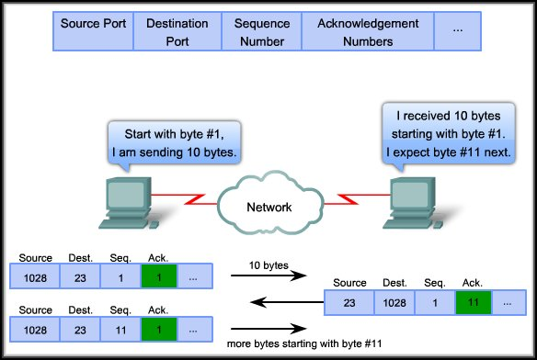
Acknowledgement Number
Expectational Acknowledgement

Slide 8
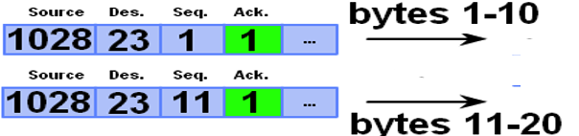

Acknowledgement Number
The acknowledgment number is cumulative.
Receiver acknowledges multiple data segments in one acknowledgement.
Sender
Receiver

Slide 9
Header Length
Header Length :
  Indicates the number of 4-byte words
  The length of the header can be between 20 and 60 bytes

Slide 10
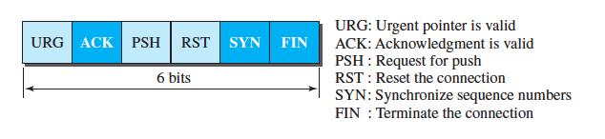
Control Bits
Control Bits:
  This field defines 6 different control bits or flags
  One or more of these bits can be set at a time
  These bits help indicate connection establishment and termination, flow control

Slide 11
Window Size
Window Size:
  This field defines size of data in bytes of the sending TCP process
  The maximum size of the window is 65,535 bytes
  Normally referred to as the receiving window (rwnd )
  The sender must obey the dictation of the receiver in this case

Slide 12

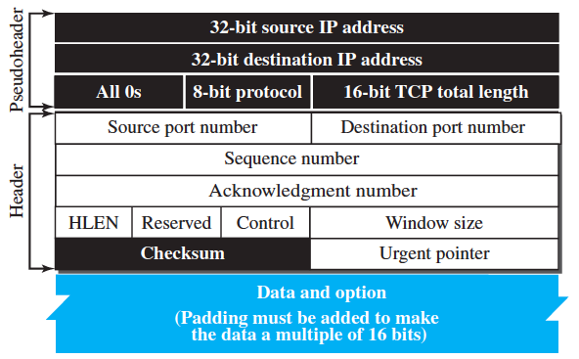
Checksum
This 16 bits field is used to detect errors (i.e., flipped bits) in the transmitted segment (intentionally or unintentionally) while traveling through the network.
Also present in UDP header
Mandatory in TCP but not in UDP
Process is same for both protocols
UDP HEADER
TCP/UDP Header
TCP/UDP Body
Pseudo IP Header

Slide 13
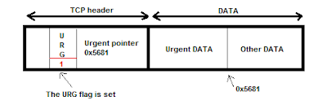

Urgent Pointer
This 16-bit field, which is valid only if the urgent flag is set.
Used when the segment contains urgent data.
It defines a value that must be added to the sequence number to obtain the number of the last urgent byte in the data section of the segment.
Urgent Data End = Current Segment's Sequence Number + Urgent Pointer Value
1500
1oo1
1001+1500

Slide 14
Options
  There can be up to 40 bytes of optional information in the TCP header
  Provides a way to deal with limitations of the original header
  For example :
    MSS (Maximum Segment Size) is defined as the largest block of data that a sender using TCP will send to the receiver

Slide 15
Functions of the Transport Layer
Primary responsibilities:
  Segmenting the data and managing each piece.
  Reassembling the segments into streams of application data.
  Identifying the different applications.
  Multiplexing
  Establishing and terminating a connection.
  Enabling error control and recovery.
  Performing flow control between end users.
UDP &TCP
Only TCP

Slide 16
Function 6
Connection Establishment and Termination for Reliability

Slide 17
Connection Establishment
TCP sets up a connection between end hosts before sending data
This process is known as ”Three-way handshake”
After the connection is established the hosts can send data

Slide 18
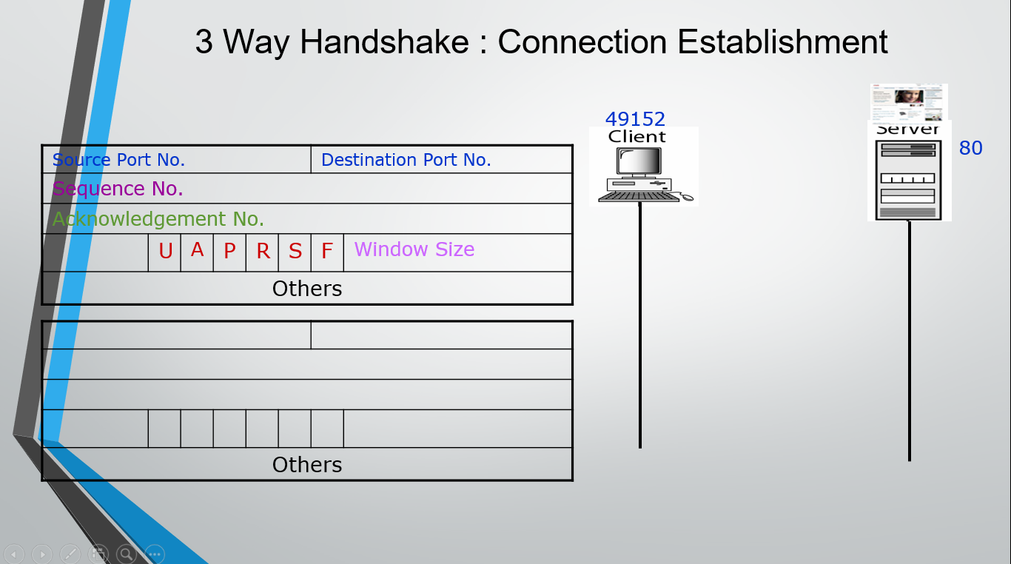

Slide 19
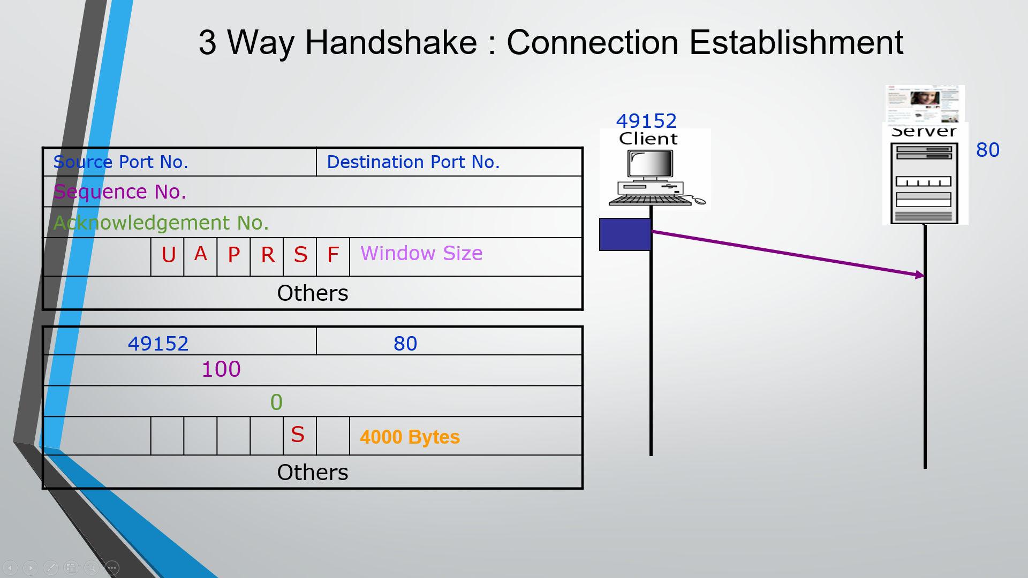

Slide 20
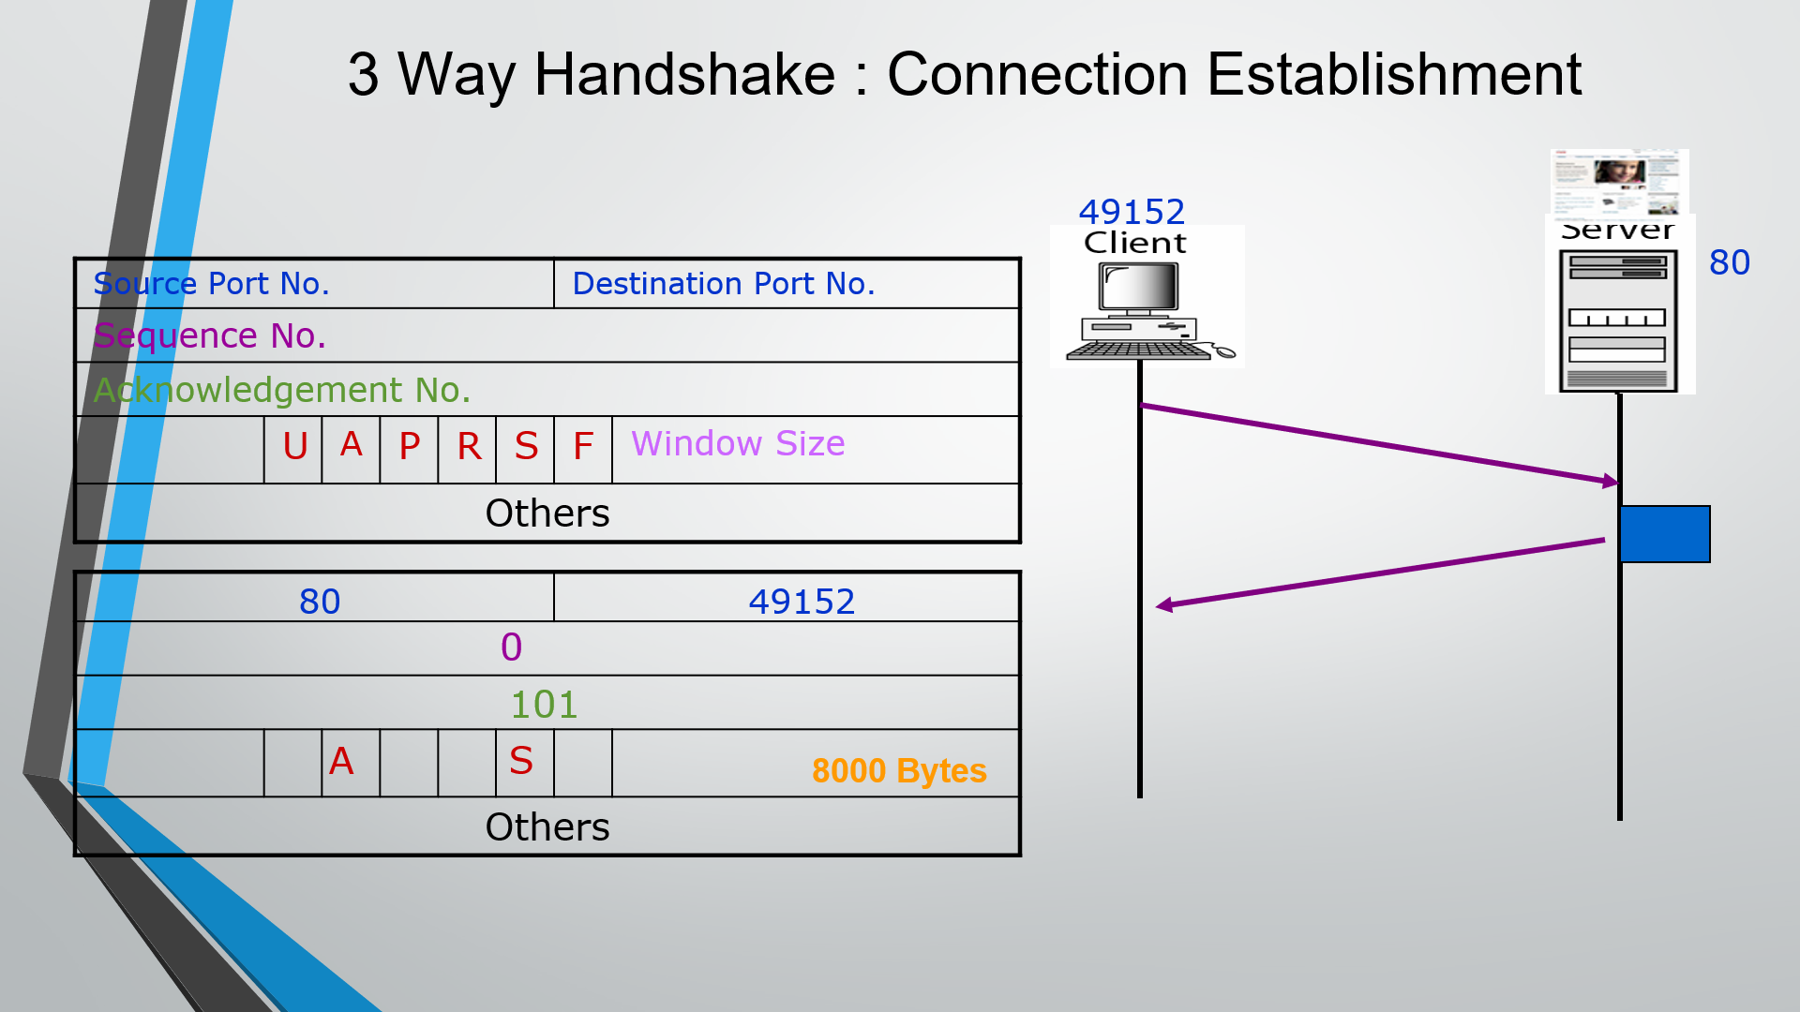

Slide 21
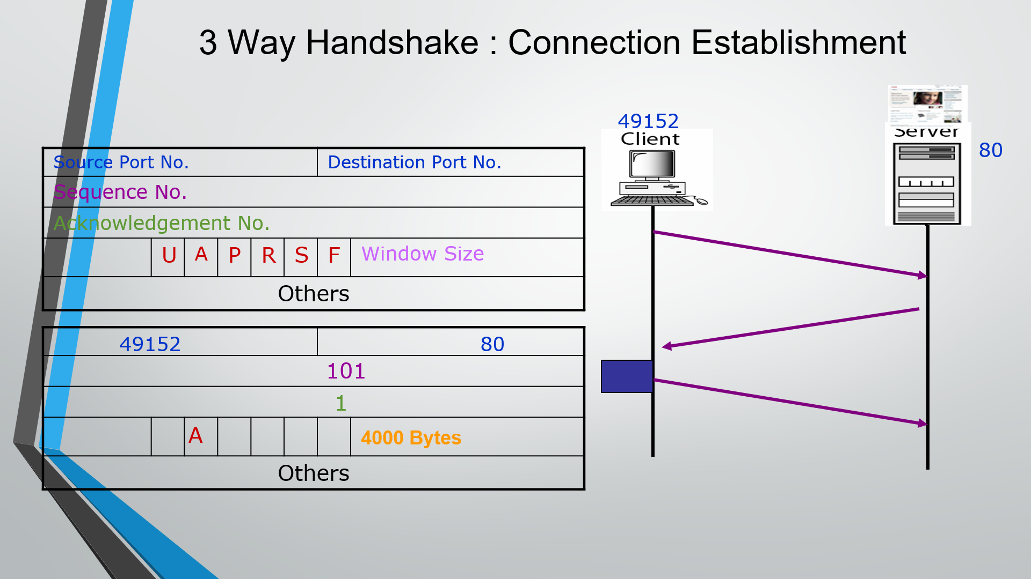

Slide 22
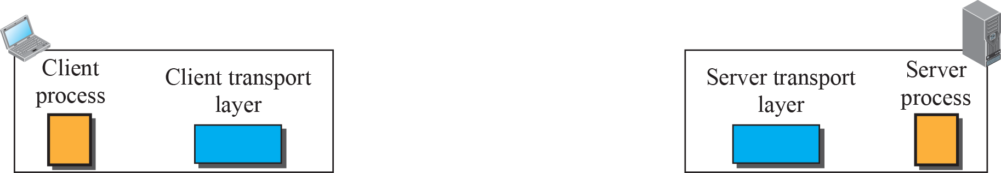
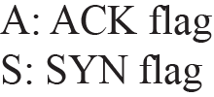
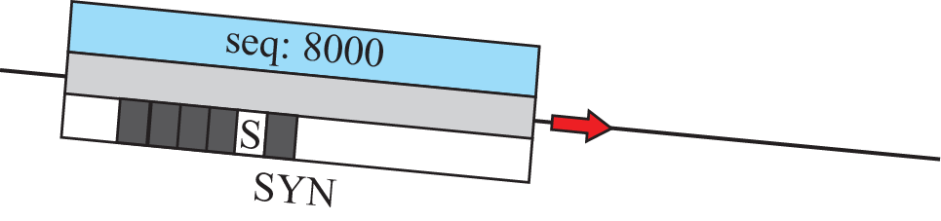


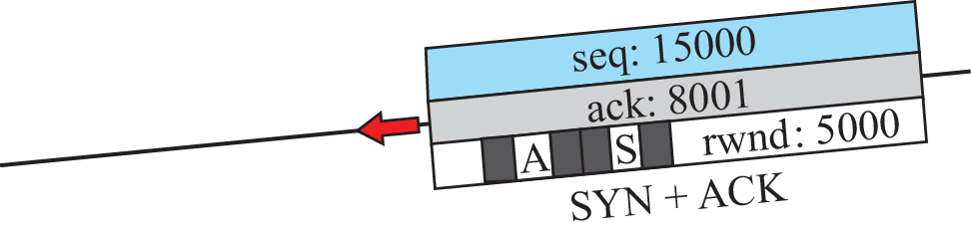
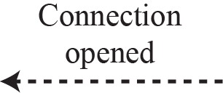
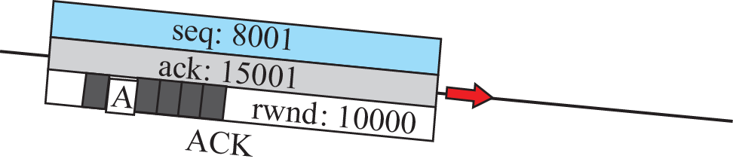
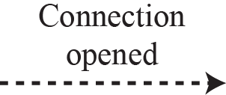

3 Way Handshake : Connection Establishment

Slide 23




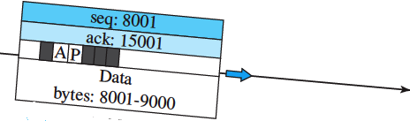
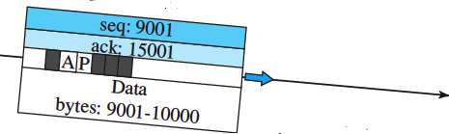
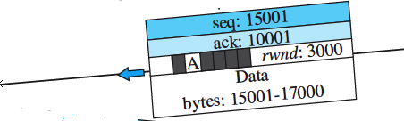
Data Transfer

Slide 24
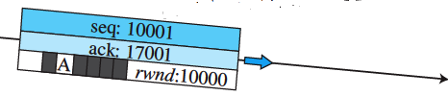

Data Transfer Continued..

Slide 25


Slide 26
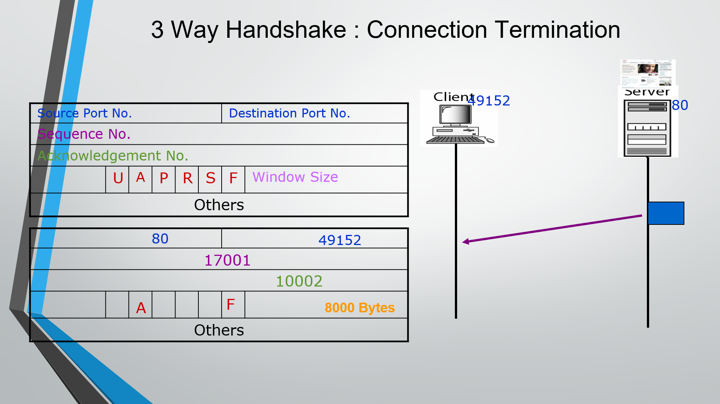

Slide 27
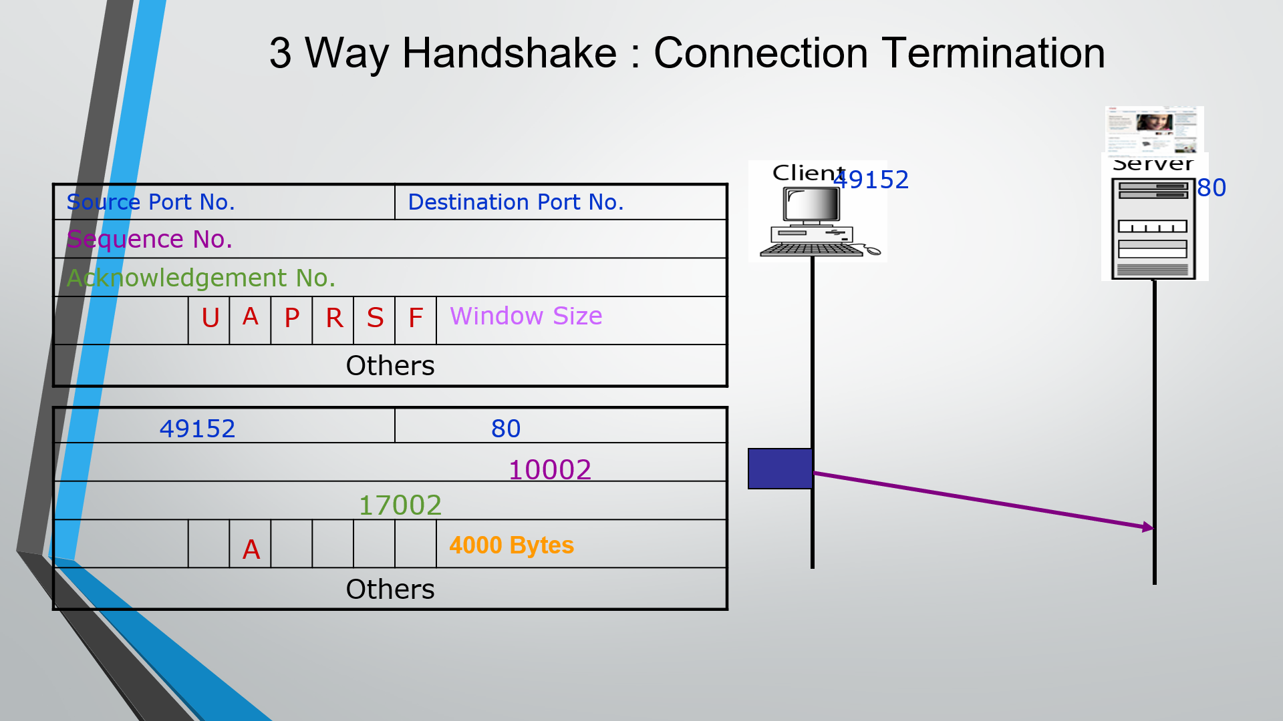

Slide 28
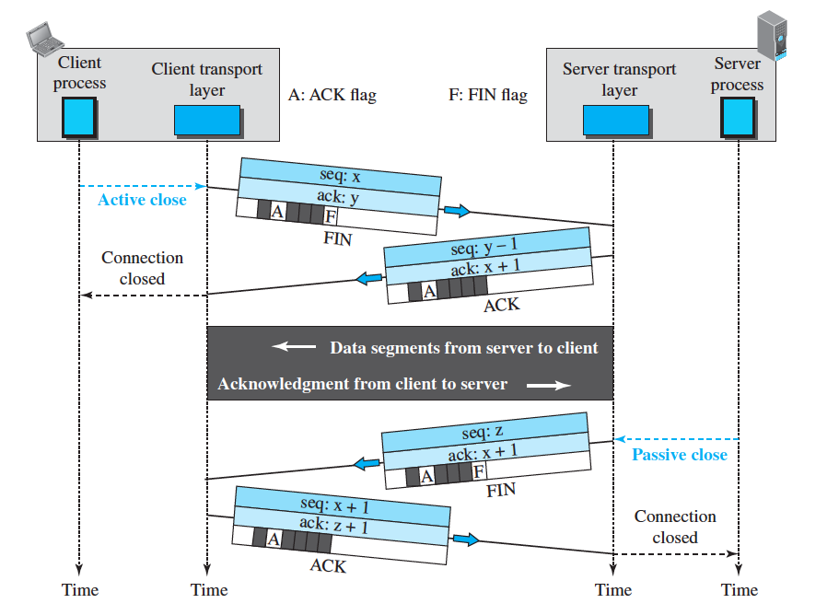

Connection Termination :: Half Close
$$+$$

Slide 29
Function 6
Error Control and Recovery for Reliability

Slide 30
Reliability in TCP
TCP provides reliability using error control
Error control includes mechanisms for
  detecting and resending corrupted segments
  resending lost segments
  storing out-of order segments until missing segments arrive
  detecting and discarding duplicated segments.
Error control in TCP is achieved through
  Checksum
  Acknowledgment
  Time-out and retransmission

Slide 31
Error Control
Checksum
  Each segment includes a checksum field, which is used to check for a corrupted segment
  If a segment is corrupted, as detected by an invalid checksum, the segment is discarded
Acknowledgment
  Using Acknowledgement Number to confirm the receipt of data segments.
  To confirm control segments that carry no data, but consume a sequence number
  ACK segments do not consume sequence numbers and are not acknowledged.

Slide 32
Error Control
Retransmission
When a segment is sent, it is stored in a queue until it is acknowledged.
Retransmission of segment will occur
  After Retransmission Time Out
  The sending TCP maintains one retransmission time-out (RTO) timer for each connection.
  When the timer matures TCP resends the segment in the front of the queue if the segment is not acknowledged
After Three Duplicate ACK Segments
  To be explained later

Slide 33

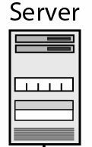

Start
Seq – 1201
Ack – 4001 [Data 200 bytes]
Normal Operation
Seq – 4001
Ack – 1401 [Data 1000 bytes]
Start
Stop
500 ms
Time Out
Seq – 1401
Ack – 5001
[no new data is sent. so sequence number of the next segment does not change]
Seq – 5001
Ack - 1401 [Data 1000 bytes]
Start
Seq – 6001
Ack- 1401 [Data 1000 bytes]
< 500 ms
Seq – 1401
Ack - 7001

Slide 34
Other Scenarios
Segment Lost or Corrupted?
Retransmission of segment ??
How will the sender know ??
What about the receiver, not aware of a packet sent?
RTO - Retransmission after time out.

Slide 35
Start
Seq – 7001
Ack – 1401 [Data 1000 bytes]
Buffer
Seq – 8001
Ack - 1401 [Data 1000 bytes]
< 500 ms
Seq – 1401
Ack - 9001
Seq – 9001
Ack – 1401 [Data 1000 bytes]
Stop
Start
Seq – 10001
Ack - 1401 [Data 1000 bytes]
Buffer
Seq – 1401
Ack - 9001
Time Out
Seq – 9001
Ack- 1401 [Data 1000 bytes]
Time out & Restart Timer
Buffer
Seq – 1401
Ack - 11001
Stop
Lost Segment

Slide 36
Out of Order Segments
TCP implementations today do not discard out-of-order segments.
They store them temporarily .
Flag them as out-of-order segments until the missing segments arrive.
Out-of-order segments are never delivered to the process.
TCP guarantees that data are delivered to the process in order.

Slide 37
Lost ACK
Seq – 11001
Ack – 1401 [Data 1000 bytes]
Start
Buffer
Seq – 1401
Ack - 12001
Seq – 11001
Ack – 1401 [Data 1000 bytes]
Time out & Restart Timer
Seq – 1401
Ack - 12001
Stop
Start
Seq – 12001
Ack- 1401 [Data 1000 bytes]
Seq – 13001
Ack- 1401 [Data 1000 bytes]
Time Out
Buffer
Seq – 14001
Ack- 1401 [Data 1000 bytes]
1
Seq – 15001
Ack- 1401 [Data 1000 bytes]
Seq – 1401
Ack - 12001
2
3 ACKs – Fast Transmission
Seq – 1401
Ack - 12001
3
Seq – 12001
Ack- 1401 [Data 1000 bytes]
Seq – 1401
Ack - 12001
Time Out Timer

Slide 38
Function 7 :
Flow Control and Recovery for Reliability

Slide 39
Flow Control
Transmission Control Protocol (TCP) uses a sliding window for flow control.
What is the “Window ”?
  Indicates the size of the device's receive buffer for the particular connection.
  How much data a device can handle from its peer at one time before it is passed to the application process.
  Set by receiver of data
  Example : The server's window size was 360. This means the receiver is willing to take no more than 360 bytes at a time from the sender.

Slide 40
Sender Sliding Window
Window Size = 100 bytes
First outstanding byte
Variables
Sf = 201
Sn = 261
Next byte to send
S_{f}
S_{n}
. . . | 200 | 201 | . . . . . | 260 | 261 | . . . . . | 300 | 301 | . . .
Bytes that are acknowledged
Outstanding Bytes
sent but not acknowledged
Bytes that can be sent (Usable window)
Bytes that cannot be sent
Window Size as advertised by the receiver

Slide 41
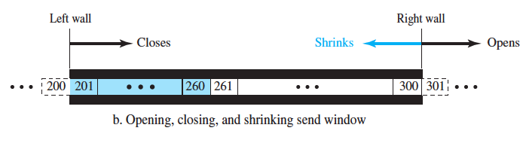
Sliding of Sender Window

Slide 42
Sliding of Sender Window
#Sender receives a segment with ACK 241
And rwnd = 60
rwnd = 100
Window Size = 100 bytes
First outstanding byte
First outstanding byte
Next byte to send
Variables
Sf = 201
Sn = 261
Variables
Sf = 241
Sn = 261
S_{f}
S_{f}
S_{n}
. . . | 200 | 201 | . . . | 241 | 242 | . . . | 260 | 261 | . . . . . | 300 | 301 | . . .
340
Outstanding Bytes
sent but not acknowledged
Bytes that cannot be sent
Bytes that are acknowledged
Bytes that are acknowledged
Outstanding Bytes
sent but not acknowledged
Bytes that can be sent (Usable window)
Window Size as advertised by the receiver

Slide 43
Receiver Sliding Window
Window Size = 100 bytes
Next byte to be pulled by process
Next byte expected to receive
R_{n}
. . . | 200 | 201 | . . . . . | 260 | 261 | . . . . . | 300 | 301 | . . .
Bytes that have already been pulled by the process
Bytes received and acknowledged, waiting to be consumed by process
Bytes that can be received from the sender
Receive window(rwnd)
Bytes that cannot be received
Receive window and allocated buffer
rwnd= buffer size – number of bytes to be pulled
= 40 bytes

Slide 44
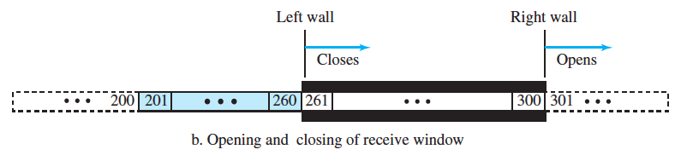
Sliding of Receiver Window

Slide 45










Flow Control Example

Slide 46





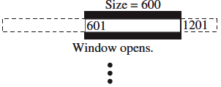



Flow Control Example Contd

Slide 47
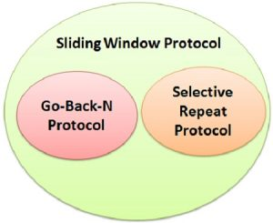
Different TCP Sliding Window Protocols
Selective Repeat Protocol
  Only those segments are re-transmitted which are found lost or corrupted
  Keep track of out of order segments at the receiver side
  More efficient for noisy channels
  Widely used in TCP

Slide 48
Go Back N ARQ
Start
Seq – 7001
Ack – 1401 [Data 1000 bytes]
Buffer
Seq – 8001
Ack - 1401 [Data 1000 bytes]
< 500 ms
Seq – 1401
Ack - 9001
Seq – 9001
Ack – 1401 [Data 1000 bytes]
Stop
Start
Seq – 10001
Ack - 1401 [Data 1000 bytes]
Buffer
Seq – 1401
Ack - 9001
Time Out
Seq – 9001
Ack- 1401 [Data 1000 bytes]
Time out & Restart Timer
Buffer
Seq – 10001
Ack - 1401 [Data 1000 bytes]
Seq – 1401
Ack - 11001
Stop

Slide 49
Different TCP Sliding Window Protocols
Go Back N Protocol
  If the sent segment are are found corrupted or lost then all the segments are re-transmitted from the lost segment to the last segment transmitted
  Do not keep track of out of order segments
  Efficient for less noisy channel

Slide 50
Overall Flow control
The initial window size is agreed during the three-way handshake.
If this is too much for the receiver and it loses data (e.g. buffer overflow) then it can decrease the window size.
If all is well then the receiver will increase the window size.

Slide 51
The End

